Slide 1




Bank Loan Management System
Group Members
Kwabena Asare Bostrom
Felix Nuworsu
Elizabeth Amponsah
Seedorf Otchere

Slide 2
Technologies Used For The Project
Frontend: Tkinter
Backend: Python

Slide 3





CHAPTER 1
Project Overview: Simulating a Core Banking Function
Three Loan Types
Financial Metrics
Risk Management Check
The system simulates a bank offering Housing, Auto, and Personal loans, each with specific parameters.
Core functionality includes accurate calculation of monthly payments and total accrued interest over the loan term.
A critical validation ensures the user's total debt-to-income (DTI) ratio remains at or below 50% of their reported income.
User-Friendly Interaction
Persistent Record Keeping
Designed for intuitive user input, robust error handling, and clear summary output.
All successfully finalized loan records are automatically saved to an external file, 'loan_records.csv'.

Slide 4

CHAPTER 2
Architectural Design: Modularity and Robustness
Our system follows a modular design principle, separating core logic into distinct functions for clarity, testability, and maintainability.
Loan Calculations
Dedicated functions implementing the amortization formula for precise payment schedules.
Input Validation
Functions responsible for ensuring all user inputs meet strict parameter requirements.
File Handling (CSV)
Isolated logic for reading, writing, and managing the permanent loan record file.
Main Control Loop
Central function managing the user workflow and sequencing the other modules.
The system relies on the standard amortization formula for payment accuracy and was thoroughly tested using Python's unittest library for functional assurance.

Slide 5


CONTRIBUTOR SPOTLIGHT
Kwabena – File Structure & Testing Lead
Responsible for establishing the project's overall file organization and developing the comprehensive unit test suite to ensure system reliability.
Test Coverage
Simulated Environments
Developed rigorous unit tests encompassing input validation rules, financial calculation accuracy, and CSV file interaction logic.
Leveraged unittests extensively to simulate complex user inputs and file system operations, ensuring repeatable test scenarios.
Architectural Foundation
Frontend Structure
Organized the project directory and module imports to support the intended modular design and efficient development.
Involved in connecting the various methods and services into the Tkinter frontend.

Slide 6

CONTRIBUTOR SPOTLIGHT
Felix – Core Financial Logic
Felix was the primary implementer of the system's core financial engine, ensuring all loan computations adhere to banking standards.
Amortization Implementation
Wrote and verified the functions calculate_monthly_payment and calculate_total_interest.
Handling Edge Cases
Developed robust logic to correctly handle scenarios such as zero interest rates, zero loan terms, and potential numerical overflow with extremely large principals, guaranteeing accurate results.
Formula Compliance
Ensured all financial calculations were mathematically sound and strictly compliant with the formulas required for the lab assignment.

Slide 7





CONTRIBUTOR SPOTLIGHT
Elizabeth – Input Validation & Constraint Checks
Elizabeth focused on creating a resilient interface that guides users and enforces critical risk management rules.
Data Integrity
Built validation routines for numerical inputs (loan amount, term) and correct loan type selection.
Debt Ratio Enforcement
Implemented the crucial check that rejects loan applications if the calculated DTI exceeds the mandated 50% limit.
User Experience
Added clear, constructive guidance and error prompts to assist users when entering invalid or restricted data.
The debt ratio check is a primary mechanism for simulating real-world financial risk assessment within the system.

Slide 8



CONTRIBUTOR SPOTLIGHT
Seedorf – Persistence and User Interface
Seedorf was key in managing data persistence and crafting the final interactive experience for the user.
Record Management
Ensured proper formatting, including the necessary header row, when saving approved loans to the CSV file.
Main UI Control
Implemented the logic for displaying calculated loan summaries and handling user confirmation/cancellation before final saving.
The seamless transition from calculation to final record storage defines the system's operational completeness.

Slide 9
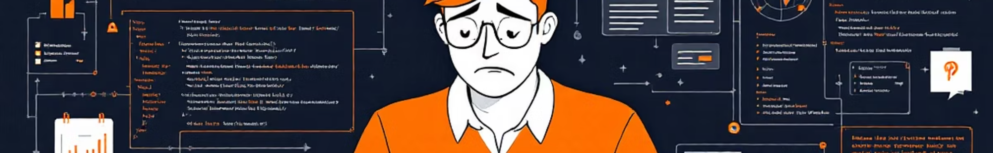




Challenges Faced
Break the tasks into manageable chunks
Making sure the structure of the code is correct
Generating test cases.
Implementing additional screens for User Login and Authentication

